Slide 1
AI in CRE What Works Now, What’s Next, and the Road Ahead
Bryan Doyle
Managing Director
CBRE Capital Markets
June 2025

Slide 2

Where we are today
Hype vs. Real Value

Slide 3
It’s all about saving time…
Data Cleanings, Preparation & Manipulation
Data Analysis & Pattern Recognition
Marketing Collateral Creation
Financial Analysis

Slide 4
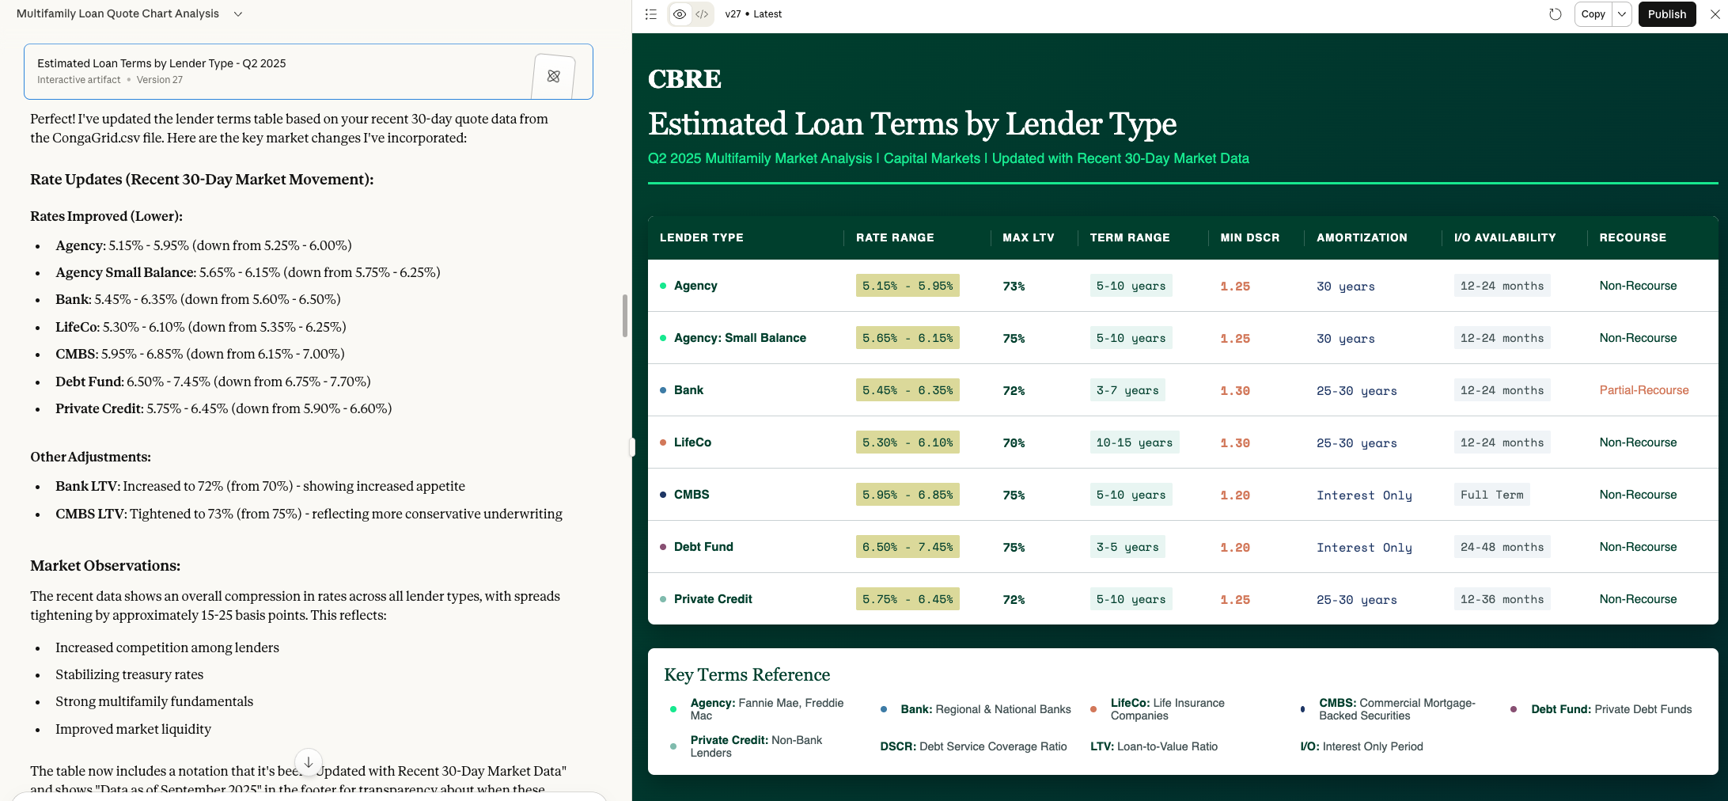
Data Analysis (Estimated Loan Terms)

Slide 5
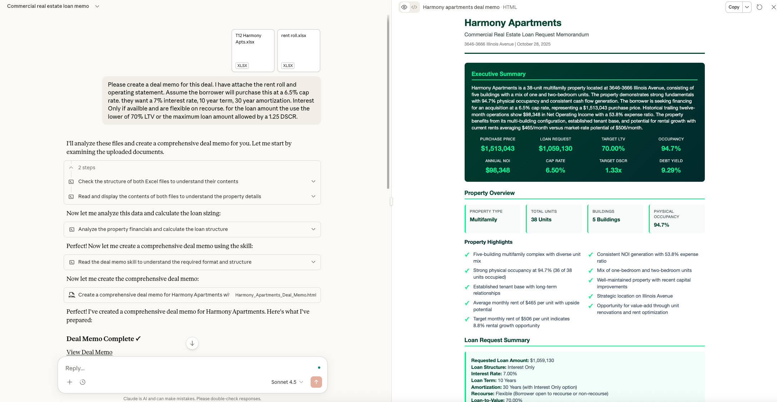
Deal Memos & Quick Screens

Slide 6

What’s next?
Tell me what I know
Tell me what I don’t know

Slide 7
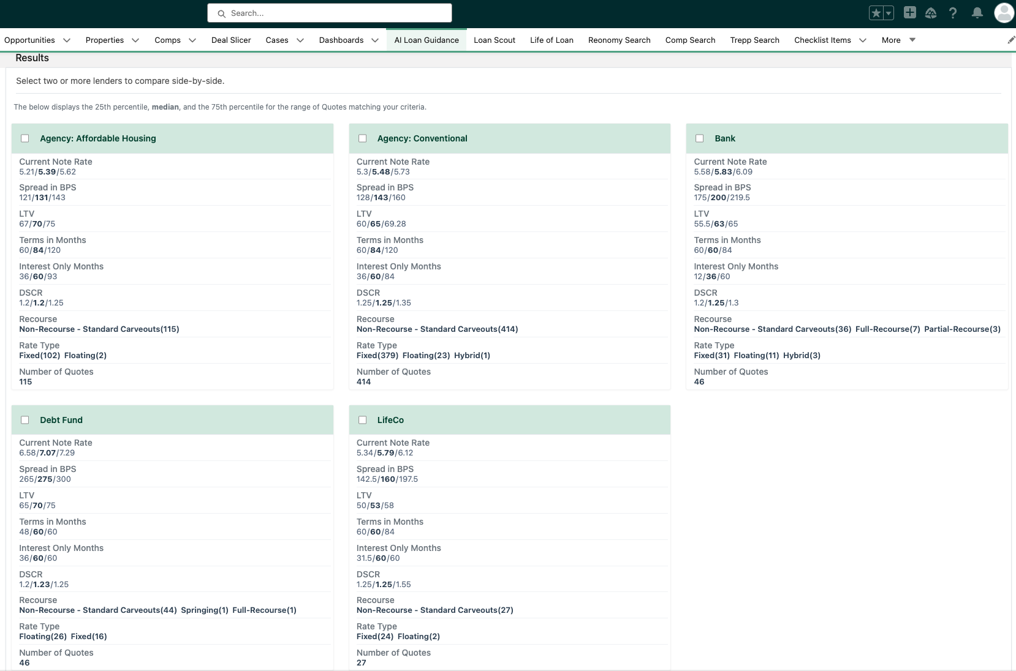
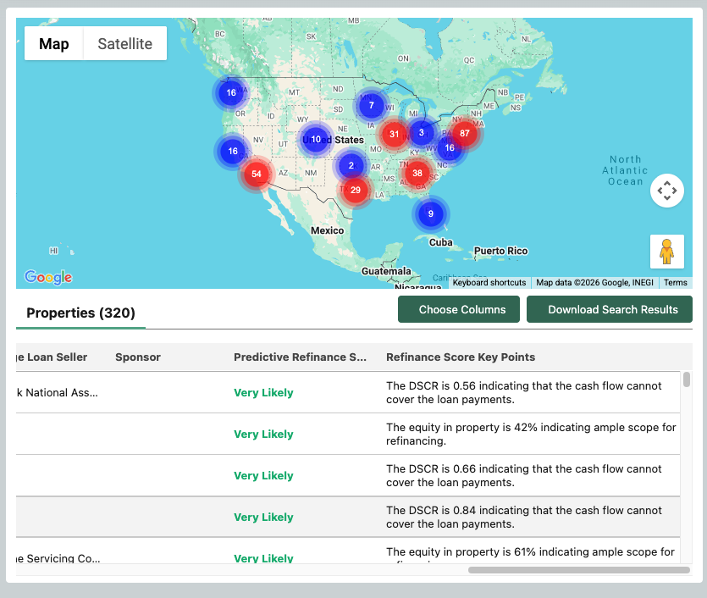
Capital AI

Slide 8
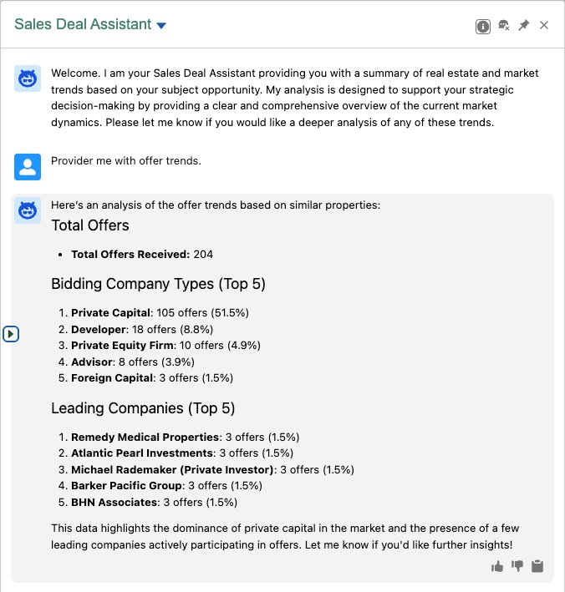
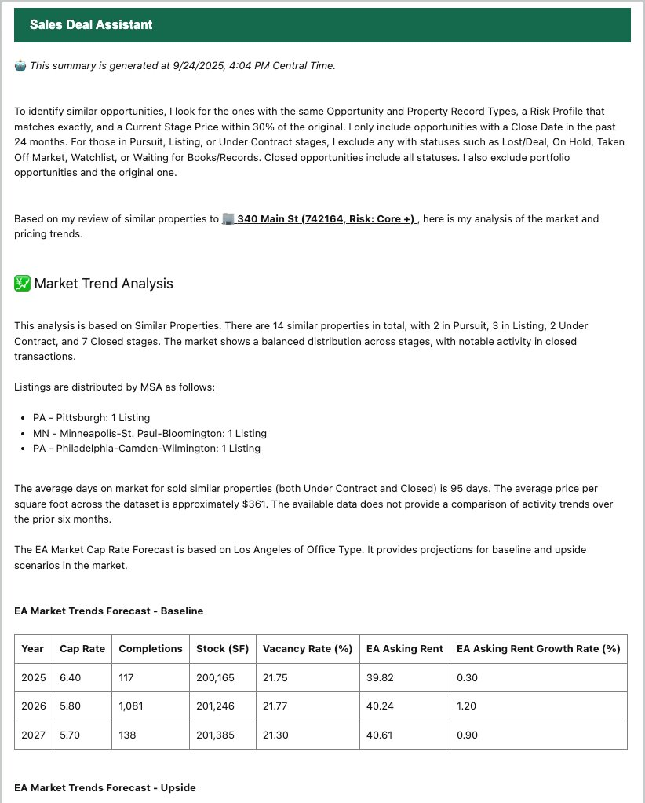
Capital AI

Slide 9
What’s next?
Tell me what I know
Tell me what I don’t know

Slide 10

What’s stopping us?
Hint: It’s not the models

Slide 11

Let’s Make Some Predictions

Slide 12

Today’s Custom App
Tomorrow’s Functionality

Slide 13

DIFFERENTIATION
It’s all about the data
Not just MORE data
But CLEAN data

Slide 14

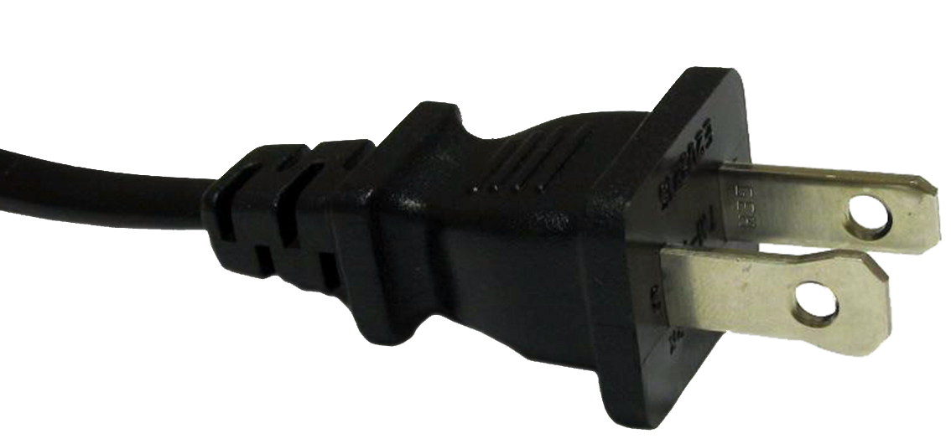
Bring Your Own Model (Data is the Asset)

Slide 15

The Future of Work
AI

Slide 16
Questions & Open Discussion

