Slide 1
Inflation, Interest Rates and Real Estate: What’s happened and What’s to Come
Ed Coulson,
Professor and Area Head, Economics
Director, Center for Real Estate

Slide 2
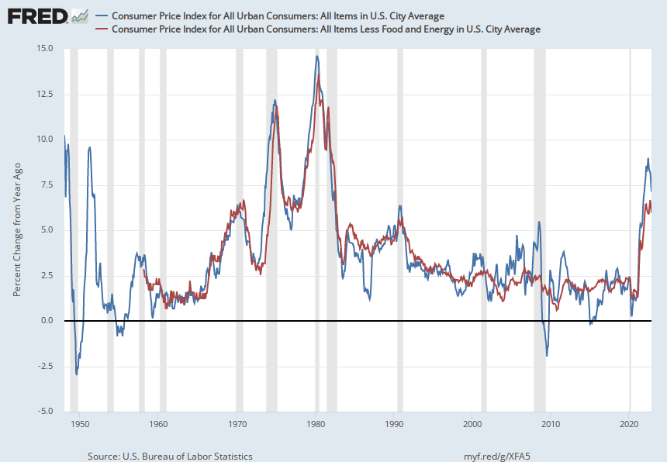
What’s new?
Notes:
Source:
Organization for Economic Co-operation and Development
Release:
Main Economic Indicators
Units:
Index 2015=100, Not Seasonally Adjusted
Frequency:
Monthly
Copyright, 2016, OECD. Reprinted with permission.All OECD data should be cited as follows: OECD (2010), "Main Economic Indicators - complete database", Main Economic Indicators (database),http://dx.doi.org/10.1787/data-00052-en (Accessed on date)
Organization for Economic Co-operation and Development,
Consumer Price Index: All Items Excluding Food and Energy for the United States [USACPICORMINMEI],
retrieved from FRED,
Federal Reserve Bank of St. Louis;
https://fred.stlouisfed.org/series/USACPICORMINMEI,
November 5, 2022.
Source:
U.S. Bureau of Labor Statistics
Release:
Consumer Price Index
Units:
Index 1982-1984=100, Seasonally Adjusted
Frequency:
Monthly
The Consumer Price Index for All Urban Consumers: All Items (CPIAUCSL) is a price index of a basket of goods and services paid by urban consumers. Percent changes in the price index measure the inflation rate between any two time periods. The most common inflation metric is the percent change from one year ago. It can also represent the buying habits of urban consumers. This particular index includes roughly 88 percent of the total population, accounting for wage earners, clerical workers, technical workers, self-employed, short-term workers, unemployed, retirees, and those not in the labor force.
The CPIs are based on prices for food, clothing, shelter, and fuels; transportation fares; service fees (e.g., water and sewer service); and sales taxes. Prices are collected monthly from about 4,000 housing units and approximately 26,000 retail establishments across 87 urban areas. To calculate the index, price changes are averaged with weights representing their importance in the spending of the particular group. The index measures price changes (as a percent change) from a predetermined reference date. In addition to the original unadjusted index distributed, the Bureau of Labor Statistics also releases a seasonally adjusted index. The unadjusted series reflects all factors that may influence a change in prices. However, it can be very useful to look at the seasonally adjusted CPI, which removes the effects of seasonal changes, such as weather, school year, production cycles, and holidays.
The CPI can be used to recognize periods of inflation and deflation. Significant increases in the CPI within a short time frame might indicate a period of inflation, and significant decreases in CPI within a short time frame might indicate a period of deflation. However, because the CPI includes volatile food and oil prices, it might not be a reliable measure of inflationary and deflationary periods. For a more accurate detection, the core CPI (CPILFESL) is often used. When using the CPI, please note that it is not applicable to all consumers and should not be used to determine relative living costs. Additionally, the CPI is a statistical measure vulnerable to sampling error since it is based on a sample of prices and not the complete average.
For more information on the consumer price indexes, see:
Bureau of Economic Analysis. "CPI Detailed Report." 2013.
Handbook of Methods
Understanding the CPI: Frequently Asked Questions
U.S. Bureau of Labor Statistics,
Consumer Price Index for All Urban Consumers: All Items in U.S. City Average [CPIAUCSL],
retrieved from FRED,
Federal Reserve Bank of St. Louis;
https://fred.stlouisfed.org/series/CPIAUCSL,
November 5, 2022.

Slide 3
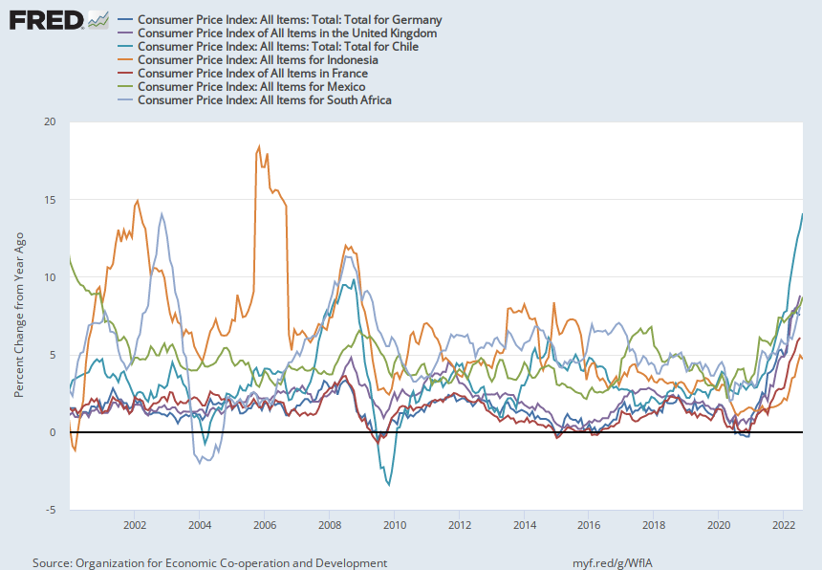
Not just our problem…

Slide 4
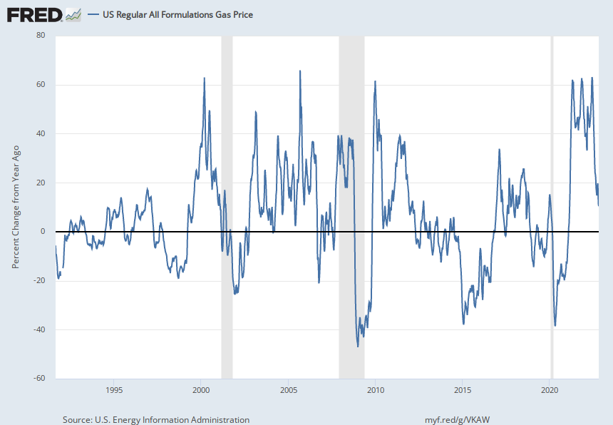
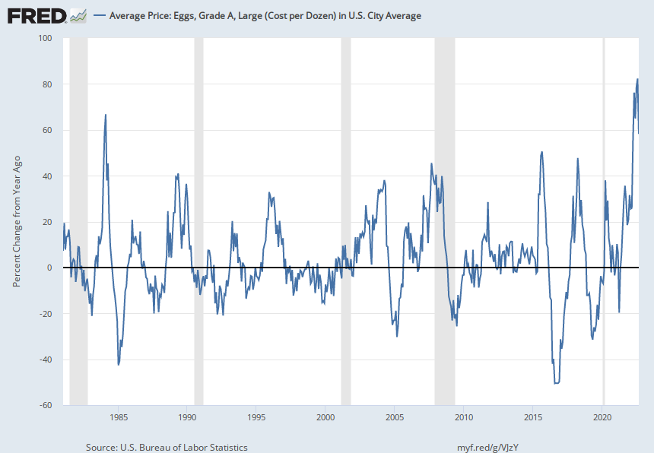
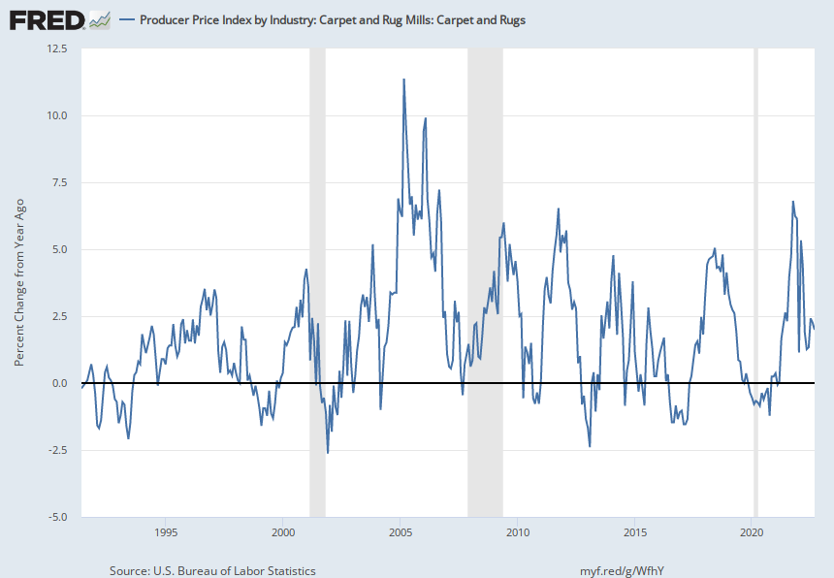
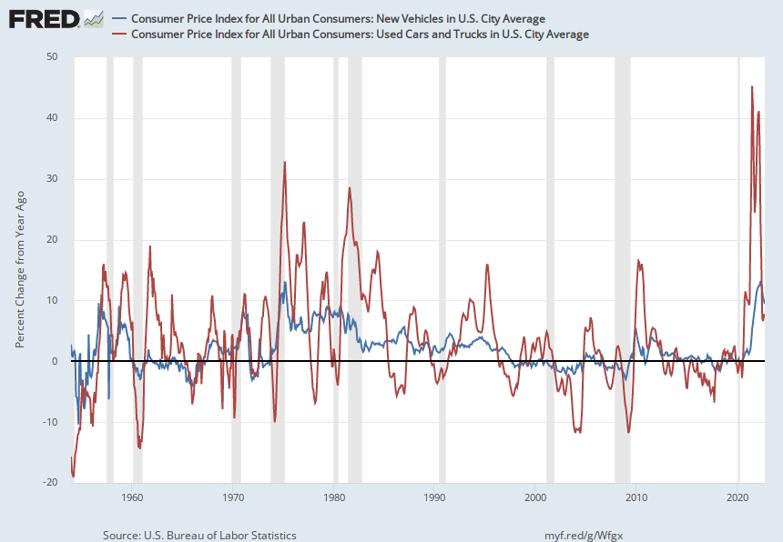
Inflation is just supply and demand

Slide 5
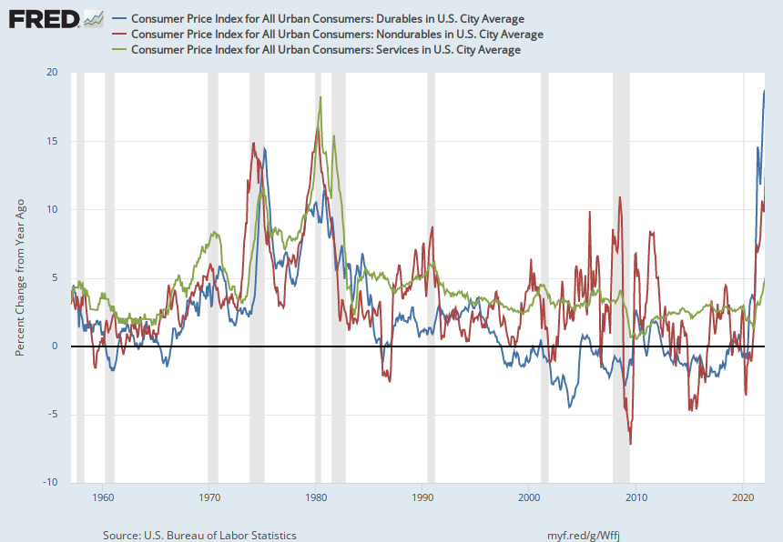
As of February 2022 it was clear where the problem was

Slide 6
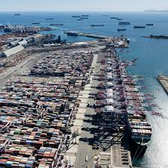
Supply chain
Efficient, but fragile, JIT supply chain was disrupted.
COVID

Slide 7
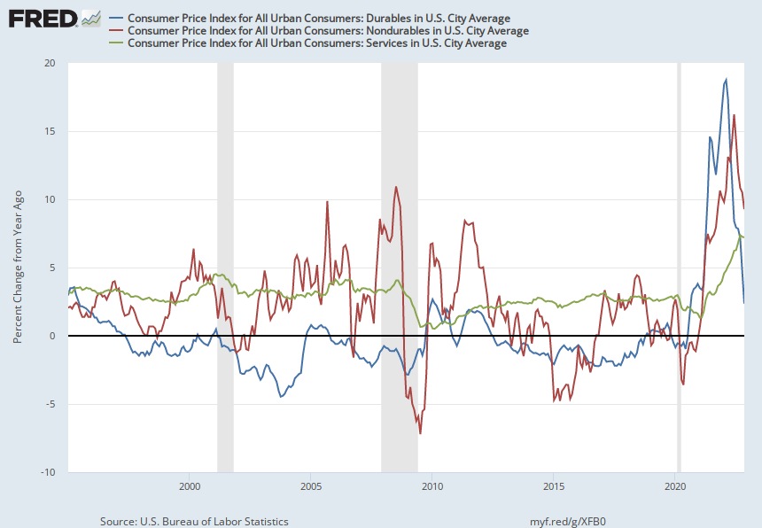
But now it seems different…

Slide 8
Supply or demand?
Services inflation now higher than for durables (and MoM would be more dramatic)
“Cost push” or “demand pull”?

Slide 9
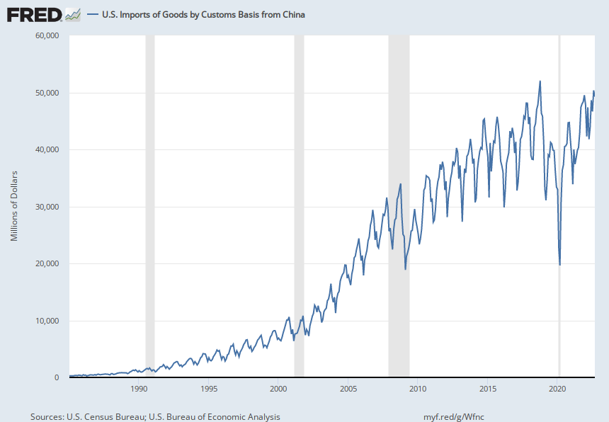
Supply side: China imports are still not what they were. (There is a bright side to this)

Slide 10
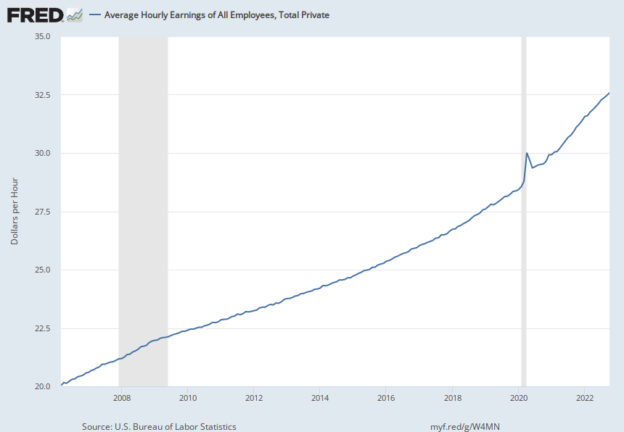
Wages

Slide 11
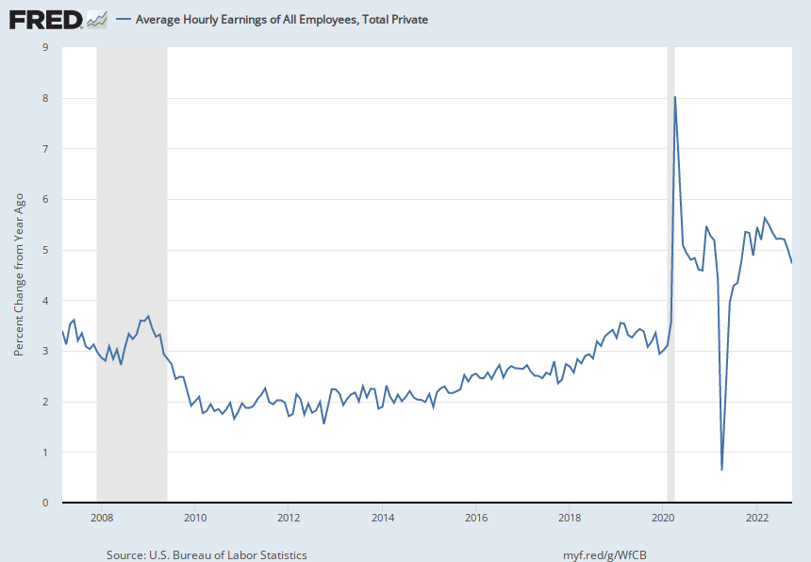

Slide 12
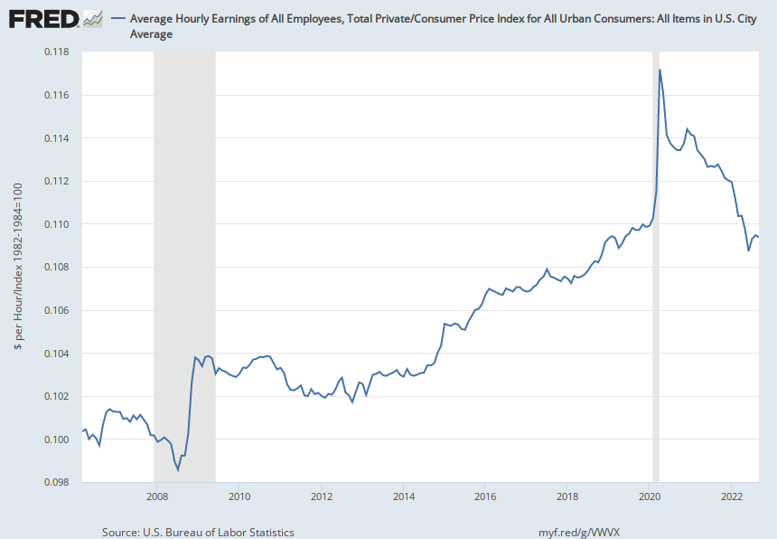
And while wages and prices form a circular bond, clearly wages have not really kept up with prices.

Slide 13
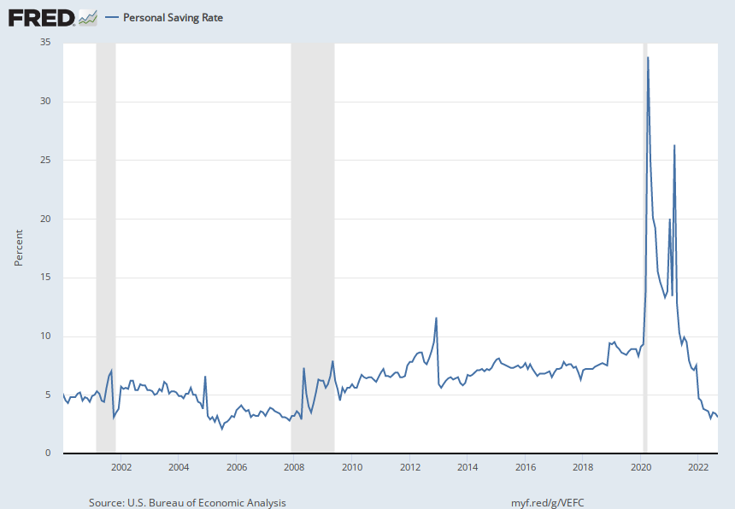
And demand: the role of stimulus payments

Slide 14
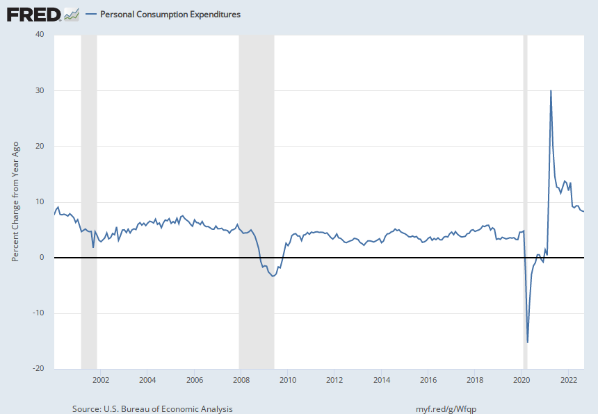
A lot of spending chasing a lot of goods (which makes for a healthy economy!)

Slide 15
What’s missing so far?

Slide 16
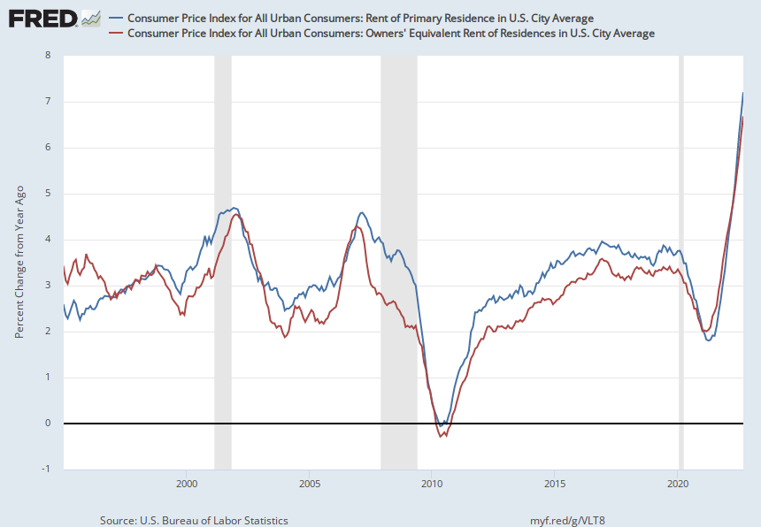

Slide 17
Rent
Rent is the biggest component in the CPI, and it is has the worst measurement problems
  Panels of rotating households report their current rent (from leases that were signed months previously).
  This is not real time rent data, inadequate for macro policy
  The ACY research agenda is here to help!

Slide 18
We have been harping on this since 2015, finally getting attention paid.

Slide 19
Month over month rental inflation: ACY vs. BLS

Slide 20
Don’t take our word for it!
Let’s check with Zillow!

Slide 21
Rents in California are already exhibiting this trend

Slide 22
A closeup since the pandemic

Slide 23
The story of rents:
  Through 2020, rising demand and unresponsive supply
  Pandemic:
    Initial panic, especially in Norcal/Silicon Valley
    Super strong recovery
      COVID induced
      Again, demand is not met with increased supply
  But we have worked through that.
    Some equilibration with other places
    California is expensive and not everybody thinks that it’s worth it.
    Sorting out who really values the good life!
    But these other places (mostly) have very similar histories.

Slide 24
Alternatives to California

Slide 25
So what about home prices?

Slide 26
Home price

Slide 27
The first year gross rate of return (R/P)

Slide 28
Three facts about prices
The run up of prices from 2015-2020 was not a bubble, even though interest rates were quite low
The steeper run up of prices from 2020 to early 2022, was bubblish.
  Some was rents
  Some was interest rates
  Falling cap
The decline is the result of both interest rate increases and flattening rents

Slide 29
The (gross) cap rate model of housing
Price = Rent/cap rate
Cap rate = discount rate - forecasted appreciation rate
Double trouble for real estate.

Slide 30
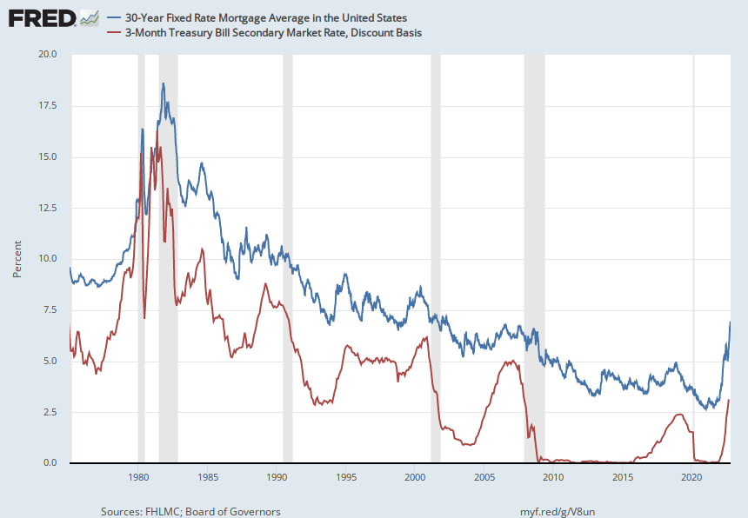
The second major headwind for home prices
Higher interest rates
Thank you, Captain Obvious
  This is especially bad for new homebuyers (and developers) but the impacts will leak into all home prices
  Nobody will want to move (refinance). Stifles the economy.

Slide 31
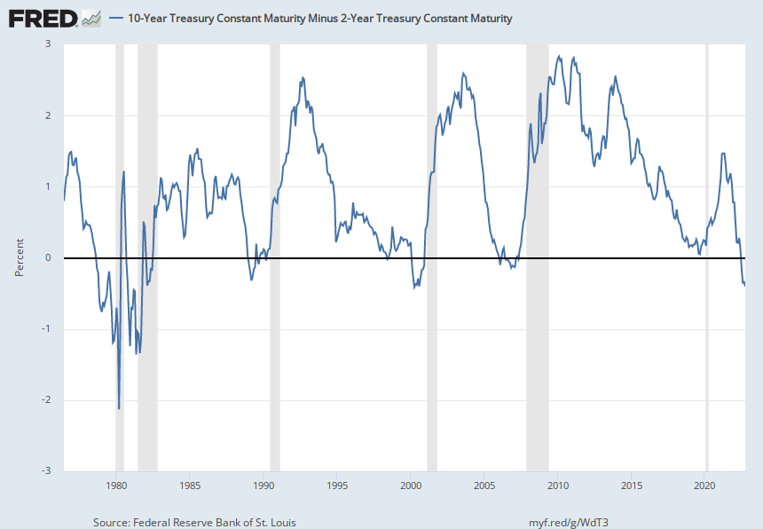
The inversion of the yield curve(s)

Slide 32
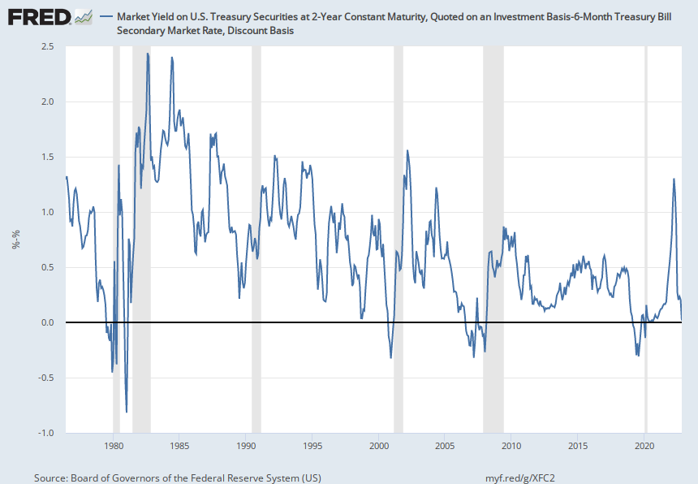
Alternative yield curve inversion

Slide 33
The Chairman will not rest
Powell’s signals are that this inequality should be reversed.
Suggests that rates increases will continue until this happens, either because rates keep rising or inflation subsides
If I am right about housing element of market basket, this will happen sooner rather than later.
Many other signals of easing inflation (gas, cars, not eggs!)

Slide 34
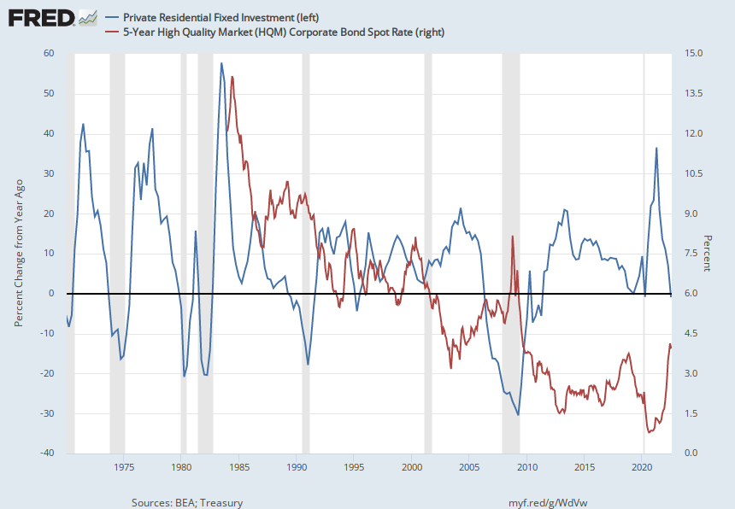
Construction activity will flatten

Slide 35
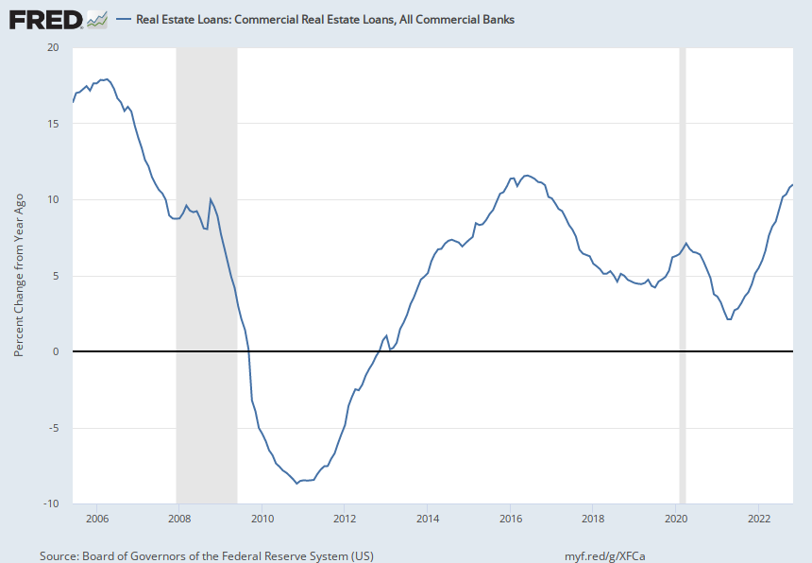
Lending is still healthy,

Slide 36
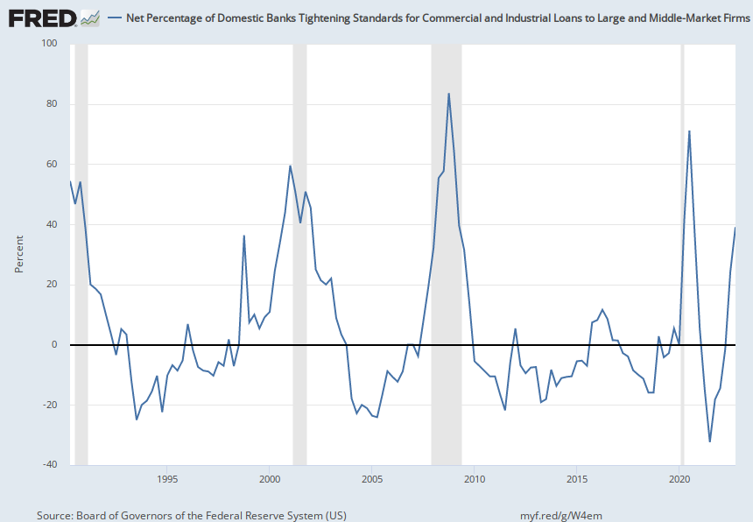
But lenders are concerned

Slide 37
So, predictions
Inflation will slacken, and sooner rather than later (sort of coming true now!)
But probably not quick enough for Powell to change his mind about (milder) rate hikes.
So there will be major pull backs in residential construction
And later, commercial development.
Could be over pretty soon

Slide 38

THANK YOU!
ncoulson@uci.edu
https://merage.uci.edu/research-faculty/centers/real-estate/index.html

